Slide 1

National Forensic Sciences University
An Institution of National Importance
(Ministry of Home Affairs, Government of India)
School of Management Studies - MBA in Business Intelligence
Semester 3
MINOR PROJECT (SEE-Jan 23)
On
Ransomware- Detection and Analysis
Guide:
Dr. Siddharth Dabhade
Name of Student Enrollment Number
VASU 101MTMBBI2122024
2021-23

Slide 2
Contents
Abstract
Introduction
Problem Statement
Literature Survey
Tools Used
Block Diagram
Result
Future Work
References

Slide 3
Abstract
In this project, the focus was on Netwalker ransomware which represents the well-known ransomware called kokoklock which has been active since September 2019. We will try to analyze the working mechanism of this ransomware how it works and how we can avoid it.
Ransomware attacks are all too common these days. Major companies in North America and Europe alike have fallen victim to it.
Recently these types of crimes have increased with the increase in digitalization. In this project, the sample execution, detection, and analysis of ransomware attacks were aimed. To prevent ransomware attacks, proper cyber hygiene must be maintained.
The importance of developing an awareness of cyber hygiene, especially after the advent of the Internet of things, which has increased the number of devices that are susceptible to infection, including phones, cars, refrigerators, and more is crucial

Slide 4
Introduction
Ransomware is a type of malicious script (malware) that threatens to publish or blocks access to data or a computer system, usually by encrypting it, until the victim pays a ransom fee to the attacker.
In many cases, the ransom demand comes with a deadline. If the victim doesn’t pay in time, the data is gone forever or the ransom increases.
Hackers are testing a destructive new way to make ransomware attacks more effective (recent news )
The frequency of these attacks steadily rises each year. Here is a list of businesses that have fallen victim to ransomware in the last six to seven months.
1. Nvidia. In February 2022, a ransomware outbreak affected the biggest semiconductor chip firm in the world. And the Lapsus$ Ransomware group is responsible for this attack.
2. Costa Rica Government: This country has declared a national emergency as a result of the ransomware attack because it has damaged both the public and private sectors, including 10 the social security fund and healthcare system of Costa Rica. This attack began between March to April 2022. Conti, a ransomware organization, is behind this strike. They initially requested $10 million from the government and eventually demanded $20 million
3. SpiceJet- Earlier this year, the Indian airline SpiceJet tried a ransomware attack, which left hundreds of customers stuck across the nation. This flight’s passengers waited for information on the departure of their journey for six hours.
4. Toyota Toyota is a large firm with several suppliers all around the world. One such supplier, Kojima Industries in Japan, was attacked and 14 Toyota units were impacted. Additionally, Denso and Bridgestone, two other Toyota suppliers, came under victimization. The attack on Denso was carried out by the Pandora group, while Bridgestone was the work of the Lockbit group.

Slide 5
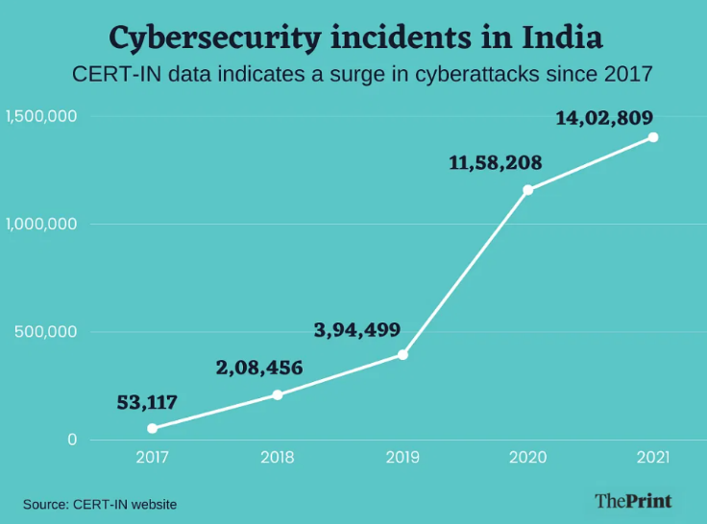
Identifying ransomware – a basic distinction must be made
Locker ransomware- This type of malware blocks basic computer functions. For example, you may be denied access to the desktop, while the mouse and keyboard are partially disabled. This allows you to continue to interact with the window containing the ransom demand in order to make the payment
Crypto ransomware- The aim of crypto-ransomware is to encrypt your important data, such as documents, pictures, and videos, but not to interfere with basic computer functions. This spreads panic because users can see their files but cannot access them.
Ransomware as a Service- Ransomware as a Service gives cybercriminals with low technical capabilities the opportunity to carry out ransomware attacks. The malware is made available to buyers, which means lower risk and higher gain for the programmers of the software

Slide 6
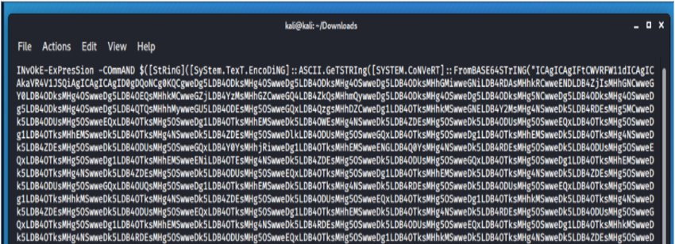
Introduction to Netwalker
In this new ransomware, the threat is not complied into PE file Threat actors are using PowerShell scripts to load the threat into the memory (using a well-known technique called reflective loading) and make it a fileless threat, more difficult to detect and analyze. For that, malware operators achieve persistence and evade detection by abusing tools that are already in the system to initiate attacks.
Recent samples of Netwalker are not distributed via social engineering attacks. Instead, it is loaded into the memory via DLL injection during a targeted attack. Thus, it doesn’t need a Windows loader to execute. This is a technique used for several PowerShell scripts, such as PowerSploit’s Invoke-Mimikatz, during Red Team operations.
Figure 1: PowerShell script used to initiate the infection process.

Slide 7
Problem Statement
The problem with ransomware is the ability not getting detection as digitalization is getting advanced day by day.
Even if cyber security is getting advanced but people are not much aware of it.
Many of the cyber threats are on social media
Modern malware is being created by skilled malware developers and includes Anti-VM and Anti-Debug technology, making it more resistant to analysis. Additionally, they deploy a packer and obfuscator to render their source code unreadable. Nowadays, many malware developers pack their malicious programs using sophisticated techniques that make it challenging for analysts to decode.

Slide 8
Literature Survey
Sr. No. | Paper Title and its Author | Details of Publication | Findings/Outcome
1 | Malware Analysis: Ransomware Author: Davide Piccardi | Publisher: Sapienza Universita Di Roma Publishing Year: 2017 | The main goal of this project is to use the information acquired in the System and Enterprise Security course's theoretical portion to explore one of the most crucial topics in cybersecurity: malware analysis.
2 | Ransomware: Recent advances, analysis, challenges and future research directions Author: Craig Beaman, Ashley Barkworth, Toluwalope David Akande, Saqib Hakak, Muhammad Khurram Khan | Publisher: ScienceDirect Publishing Year: 2021 | Recent developments in ransomware analysis, detection, and prevention were examined in this article. It was discovered that honeypots, network traffic analysis, and machine learning-based methods are primarily the focus of cutting-edge ransomware detection tools.

Slide 9
Sr. No. | Paper Title and its Author | Details of Publication | Findings/Outcome
3 | Demystifying Ransomware Attacks: Reverse Engineering and Dynamic Malware Analysis of WannaCry for Network and Information Security Authors: : Aaron Zimba, Luckson Simukonda, Mumbi Chishimba | Publisher: Zambia ICT Journal Publishing Year: 2017 | Nowadays, cloud storage services are becoming more well-known. Among cloud computing services, most people uses cloud storage services for managing doc the easy accessibility of cloud storage has contributed to the spread of cloud storage services
4 | Ransomware Evolution, Target and Safety Measures Author: Neeraj Kumar, Alka Agrawal, Prof. Raees Ahmad Khan | Publisher: Research gate Publishing Year: 2018 | This article provides some basic information regarding ransomware, how it operates, and recommendations for defending systems and the paper provides an overview of the development of ransomware, including its impact on the system, mode of operation, and techniques for protecting our data while under attack

Slide 10
Sr. No. | Paper Title and its Author | Details of Publication | Findings/Outcome
5 | Ransomware: A Research and a Personal Case Study Of Dealing With This Nasty Malware Author: Azad Ali | Publisher: Issues in Information Systems : 2017 | This essay discussed ransomware, a terrible form of malware that targets users' computers, encrypts files, blocks access to computers and data files, and then demands payment in exchange for the functionality of the machines and files to be restored.
6 | Ransomware Evolution, Target and Safety Measures Neeraj Kumar, Alka Agrawal, Prof. Raees Ahmad Khan | Publisher: Research gate Publishing Year: 2018 | This paper describes the evolution of ransomware and some of the general traits of a few well-known ransomware. The report presents research from the very first ransomware to the present day in the evolution section.

Slide 11
Tools Used
Virtual machine technology is used for many use cases across on-premises and cloud environments. More recently, public cloud services are using virtual machines to provide virtual application resources to multiple users at once, for even more cost-efficient and flexible computing. Each virtual machine runs its own operating system and functions separately from the other VMs, even when they are all running on the same host.
Oracle VM - VirtualBox is a powerful x86 and AMD64/Intel64 virtualization product for enterprise as well as home use. Not only is VirtualBox an extremely feature-rich, high-performance product for enterprise customers, it is also the only professional solution that is available as Open source.
Power Shell - PowerShell is a cross-platform task automation solution made up of a command-line shell, a scripting language, and a configuration management framework.
Power Shell Scripting- Windows PowerShell is a command-line shell and scripting language designed especially for system administration. Its analog in Linux is called Bash Scripting. Built on the .NET Framework,
JSON- The structures of simple data sets are stored in JavaScript Object Notation or JSON format. It is based on text, is lightweight, has a format that humans can read, and is a standard data interchange format. It contains a .json file extension and is similar to the XML file format.

Slide 12
Facts and Figure
In 2021, ransomware cost the global economy $20 billion. By 2031, that amount is anticipated to reach $265 billion. (https://www.globalreinsurance.com/ransomware-costs-to-reach-20- billion-in-2021/1437206.article)
Ransomware affected 37% of all companies and organisations in 2021. (https://www.wilmingtonbiz.com/insights/jeremy_tomlinson/37_of_orgs_said_they_were_the_victim_of_ransomware_in_2021/3292)
In 2021, businesses spent an average of $1.85 million on ransomware recovery. (https://www.sophos.com/en-us/press-office/pressreleases/2021/04/ransomware-recovery-cost-reaches-nearly-dollar-2- million-more-than-doubling-in-a-year)
According to a new report, ransomware attacks are increasing at a "alarming" rate. (https://www.cybertalk.org/2022/05/26/ransomware-attacksincrease-at-alarming-rate-according-to-new-report/)
Nearly 30 government organization's in Costa Rica were the target of a cyberattack, including the Ministry of Finance and the Ministry of Science, Innovation, Technology, and Telecommunications (MICITT). (https://en.wikipedia.or/wiki/2022_Costa_Rican_ransomware_attack).

Slide 13
Block Diagram
Part of the source code with two DLL files — for x64- and x86-bit OS.
Ransomware execution and config
Install VM
infection process
Block of data not encrypted by Netwalker ransomware.
Ransom note and onion links available on the JSON configuration
The ransom note is encoded in Base64 and can be observed
After encrypting all the files, the text file with the ransom note is dropped by Netwalker with the fields coded in the config now populated.

Slide 14
Future Work
For the next stage, focus would be on the practical part of the project.
The main model creation
Application of ML and Security Model
would be implemented using trial and error of various tools
More case studies will try to include and will try to publish to article in future.

Slide 15
Result
By this project I want to make awareness about recent ransomware activities and trying to understand basic working and mechanism about it.
Recent articles and blog and various research paper has been considered in the project .

Slide 16
Mitigation Measures
The first and principal recommendation in these cases of data encryption incidents is to never pay the ransom requested by the cybercriminals. Among the preventative measures to be taken, it is important to highlight the following:
Don’t downloaded and execute suspicious files from unknown sources
Use PowerShell commands such as Constrained Language Mode to secure systems from malicious code
Make backups periodically and be ensure that system can be re-established quickly with the minimal loss of information
Improve network segmentation to prevent massive propagation threats this nature
Review and reinforce security policies
Create awareness programs educating employees on the dangers of social engineering

Slide 17
References
List of papers/books/websites etc. referred for project
[1]Toyota's 14 factories in Japan are shut down for 24 hours due to a cyberattack on its supply chain. (https://edition.cnn.com/2022/03/01/business/toyota-japancyberattack-production-restarts-intl-hnk/index.html).
[2] Cyberattack Using Ransomware Affects Nvidia and Samsung. (https://www.msn.com/EN-US/news/other/nvidia-samsung-facehuge-cyber-attack-you-could-be-next/ar-AAUK7Bw).
[3] Nearly 30 government organizations in Costa Rica were the target of a cyberattack, including the Ministry of Finance and the Ministry of Science, Innovation, Technology, and Telecommunications (MICITT). (https://en.wikipedia.or/wiki/2022_Costa_Rican_ransomware_attack).
[4] SpiceJet: Passengers left stranded after ransomware hit on Indian airline. (https://www.bbc.com/news/world-asia-india-61575773).
[5] Introduction to ransomware – Netwalker ransomware
https://seguranca-informatica.pt/netwalker-ransomware.
[6] A Complete Dynamic Malware Analysis, Navroop Kohli, Dr Amit Kumar Bindal, 2016 Kohli, Navroop & Bindal, Dr. Amit. (2016). A Complete Dynamic Malware Analysis. International Journal of Computer Applications. 135. 20-25. 10.5120/ijca2016908283.
[7] Ransomware: A Research and a Personal Case Study of Dealing With This Nasty Malware Author: Azad Ali Publisher: Issues in Information Systems Publishing Year: 2017.
[8] Ransomware Evolution, Target, and Safety Measures Author: Neeraj Kumar, Alka Agrawal, Prof. Raees Ahmad Khan Publisher: ResearchGate Publishing Year: 2018.

Slide 18
Any Question?
Thank you !

